Slide 1

CS212: Object-Oriented Programming
Introduction
Ayesha Kanwal
Ayesha.kanwal@seecs.edu.pk
Slides Courtesy (Dr Nazia Perwaiz)

Slide 2
RECAP
Understand object-oriented programming basics
Introduce Object-oriented analysis-and-design (OOAD) process
Learn a typical Java program development environment
Write simple Java applications

Slide 3
OBJECTIVES
Control Structures in Java
  Sequence structure
  Selection structure
  Repetition structure
  Break/ Continue
Increment/ decrement operators
Logical operators

Slide 4
Control Structures in Java
We learn about Control Structures
  Structured-programming principle
  Control structures help build and manipulate objects
Program control
  Specifying the order in which actions execute
    Control structures help specify this order

Slide 5
Control Structures
Sequential execution
  Program statements execute one after the other
Transfer of control
  Three control statements can specify order of statements
    Sequence structure
    Selection structure
    Repetition structure

Slide 6
Control Structures
Flowchart
  Graphical representation of algorithm
    Flowlines indicate order in which actions execute

Slide 7
Flowchart Example
Flowlines
Action Symbols
add grade to total
total = total + grade;
add 1 to counter
counter = counter +
1
;
Connector Symbols
    Fig 1: Flowcharting Java’s sequence structure.

Slide 8
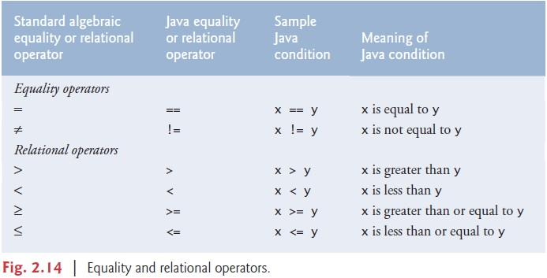
Equality & Relational Operators

Slide 9
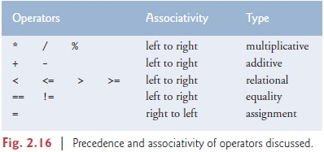
Equality & Relational Operators

Slide 10
Control Structures
Java has a sequence structure “built-in”
Java provides three selection structures
  if
  if/else
  Switch
Java provides three repetition structures
  while
  do/while
  for

Slide 11
Control Structures - Single Selection
The if Selection Structure
  Single-entry/single-exit/ single-selection structure
  Perform action only when condition is true
  Action/decision programming model

Slide 12
Control Structures - Single Selection
The if Selection Structure
Decision Symbol
true
grade >= 60
print “Passed”
false
    Fig 2: Flowcharting the single-selection if structure.

Slide 13
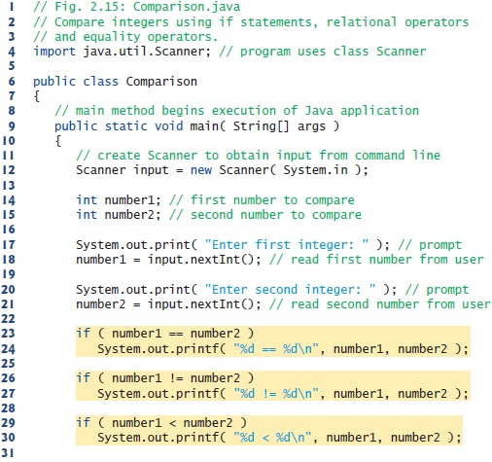



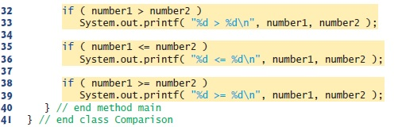

Slide 14
Control Structures - Double Selection
The if/else Selection Structure
  Perform action only when condition is true
  Perform different specified action when condition is false

Slide 15

Control Structures - Double Selection
The if/else Selection Structure
false
true
grade >= 60
print “Failed”
print “Passed”
    Fig 3: Flowcharting the double-selection if/else structure.

Slide 16
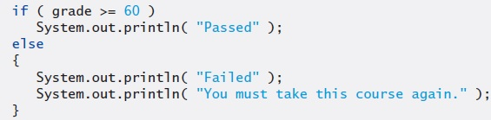
Control Structures
Blocks
  The if statement normally expects only one statement in its body
  To include several statements in the body of an if (or the body of an else for an if…else statement), enclose the statements in braces
  Statements contained in a pair of braces form a block

Slide 17
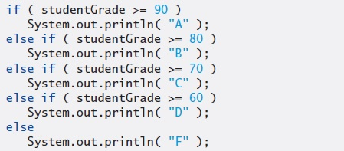
Control Structures
Nested if…else Statements
  A program can test multiple cases by placing if…else statements inside other if…else statements

Slide 18
Common Programming Error (Logical Error)
if (x > 10)
{
System.out.print("x is greater than 10");
}
VS
if (x > 10);
{
System.out.print("x is greater than 10");
}
SAME ?

Slide 19
Common Programming Error (Syntax Error)
if (x > 10)
System.out.print("x is greater than 10");
else
System.out.print("x is not greater than 10\n");
VS
if (x > 10) ; // Semicolon ends the if statement
System.out.print("x is greater than 10"); // Always executes
else // Orphan else
System.out.print("x is not greater than 10\n");

Slide 20
Common Programming Error
Placing a semicolon after the condition in an if or if…else statement leads to a logic error in single-selection if statements
&
a syntax error in double-selection if…else statements (when the if-part contains an actual body statement).

Slide 21
Conditional Operator (?:) - Selection
An alternative to if/else statement
Java’s only Ternary operator (operator that takes three operands)
Example:
System.out.println( studentGrade >= 60 ? "Passed" : "Failed" );

Slide 22
Control Structures - Repetition
while Repetition Statement
  Repeat action while a condition remains true
true
product <= 100
product = 3 * product
false
    Fig 4: Flowcharting the while repetition structure.

Slide 23
Common Programming Error
Not providing in the body of a while statement an action, that eventually causes the condition in the while to become false normally results in a logic error called an infinite loop (the loop never terminates).

Slide 24
Counter-Controlled Repetition
Counter
  A variable that controls number of times a set of statements executes
Example case study
  A class of ten students took a quiz. The grades (integers in the range 0 to 100) for this quiz are available to you. Determine the class average on the quiz.

Slide 25
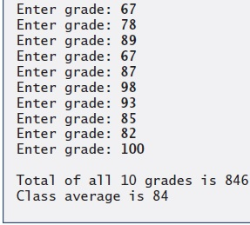
Counter-Controlled
Repetition
01 // Importing the Scanner class
02 import java.util.Scanner;
03
04 public class Average1
05 {
06 // main method begins execution of Java application
07 public static void main( String args[] )
08 {
09 int total, // sum of grades input by user
10 gradeCounter, // number of grades entered
11 gradeValue, // grade value
12 average; // average of all grades
13
14 // Initialization Phase
15 total = 0; // clear total
16 gradeCounter = 1; // prepare to loop
17 Scanner input = new Scanner(System.in);
18
19 // Processing Phase
20 while ( gradeCounter <= 10 ) // loop 10 times
21 {
22 // prompt for input and read grade from user
23 System.out.print("Enter grade: ");
24 gradeValue = input.nextInt( );
25
26 // add gradeValue to total
27 total = total + gradeValue;
28
29 // add 1 to gradeCounter
30 gradeCounter = gradeCounter + 1;
31 }
32 average = total/10; // Compute average & display result
33 System.out.printf(“Total of all 10 grades is %d\n", total);
34 System.out.printf(“Class average is %d\n", average);
35 }
36 }
Declare variables; gradeCounter is the counter
Continue looping as long as gradeCounter is less than or equal to 10

Slide 26
Sentinel-Controlled Repetition
Sentinel value
  Used to indicated the end of data entry
  E.g., User enters sentinel value (-1) to end repetition
Often called an indefinite repetition
Example case study
  Develop a class-averaging program that processes grades for an arbitrary number of students each time it’s run.

Slide 27
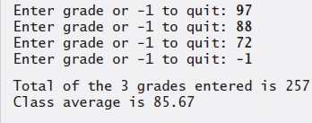
Sentinel-Controlled Repetition
01 import java.util.Scanner;
02 public class Average2
03 {
04 // main method begins execution of Java application
05 public static void main( String args[] )
06 {
07 int total, gradeCounter, gradeValue;
08 double average;
09
10 // Initialization Phase
11 total = 0;
12 gradeCounter = 0;
13 Scanner input = new Scanner(System.in);
14
15 // prompt for input and read grade from user
16 System.out.print("Enter grade or -1 to quit: ");
17 gradeValue = input.nextInt( );
18
19 // Processing Phase
20 while (gradeValue != -1 )
21 {
22 total = total + gradeValue;
23 gradeCounter = gradeCounter + 1;
24
25 // prompt for input and read grade from user
26 System.out.print("Enter grade or -1 to quit: ");
27 gradeValue = input.nextInt( );
28 }
29 if (gradeCounter != 0 )
30 {
31 average = (double) total / gradeCounter; // Compute average & display
32 System.out.printf(“Total of the %d grades entered is %d\n", gradeCounter, total);
33 System.out.printf(“Class average is %.2f\n", average);
34 }
35 else System.out.println(“Please enter valid grades");
36 }
37 }
loop until gradeValue equals sentinel value (-1)

Slide 28
Sentinel-Controlled Repetition
import java.util.Scanner;
public class Main{
// main method begins execution of Java application
public static void main( String args[] )
{
int total, gradeCounter, gradeValue;
double average;
// Initialization Phase
total = 0;
gradeCounter = 0;
Scanner input = new Scanner(System.in);
// prompt for input and read grade from user
System.out.print("Enter grade or -1 to quit: ");
gradeValue = input.nextInt( );
// Processing Phase
while (gradeValue!=-1 ){
total = total + gradeValue;
gradeCounter = gradeCounter + 1;
// prompt for input and read grade from user
System.out.print("Enter grade or -1 to quit: ");
gradeValue = input.nextInt( );
}
if (gradeCounter != 0 ){
average = (double) total / gradeCounter; // Compute average & display
System.out.printf("Total of the %d grades entered is %d\n", gradeCounter, total);
System.out.printf("Class average is %.2f\n", average);
}
else System.out.println("Please enter valid grades");
}
}

Slide 29
Compound Assignment Operators
Abbreviate assignment expressions
Any statement of form
  variable = variable operator expression;
Can be written as
  variable operator= expression;
E.g., addition assignment operator +=
  c = c + 3;
Can be written as
  c += 3;

Slide 30
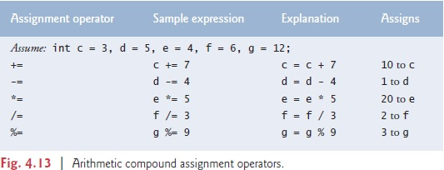
Compound Assignment Operators

Slide 31
Increment & Decrement Operators
Unary increment operator (++)
  Increment variable’s value by 1
Unary decrement operator (--)
  Decrement variable’s value by 1
Pre-increment / pre-decrement operator
Post-increment / post-decrement operator

Slide 32
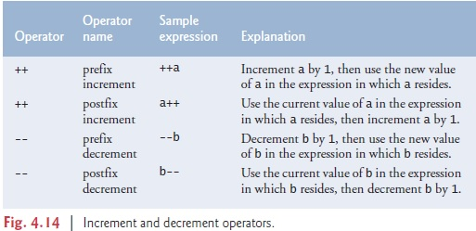
Increment & Decrement Operators

Slide 33
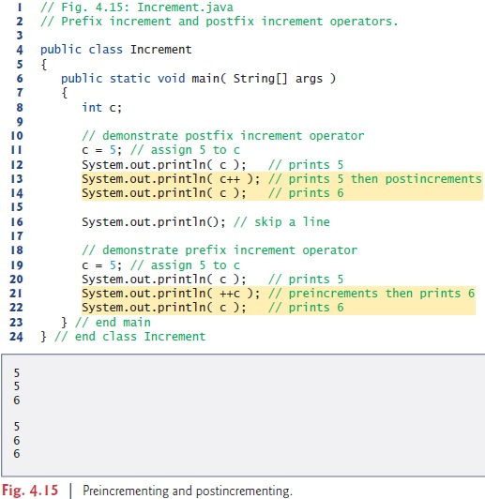

Slide 34
Increment & Decrement Operators
// Online Java Compiler
// Use this editor to write, compile and run your Java code online
import java.util.Scanner;
class Main {
public static void main(String args[]) {
Scanner input = new Scanner(System.in);
int c = 5;
System.out.println(c);
System.out.println(c++);
System.out.println(c);
System.out.println(++c);
input.next();
System.out.println(c--);
System.out.println(c);
System.out.println(--c);
System.out.println(c);
input.next();
System.out.println((c+1));
//System.out.println((c+1)++); // Is this fine?
input.close();
}
}

Slide 35
Common Programming Error
Attempting to use the increment or decrement operator on an expression other than one to which a value can be assigned is a syntax error. For example, writing ++(x + 1) is a syntax error, because (x + 1) is not a variable.

Slide 36
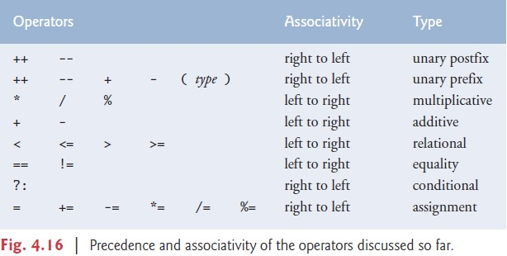

Slide 37
Primitive Data Types
Primitive types
  “building blocks” for more complicated types
Java is statically typed
  Variables must be explicitly declared with a type before use.
  The type cannot change once assigned.
Java is strongly typed
  All variables in a Java program must have a type.
  A strongly typed language does not allow implicit type conversion between unrelated types.
Java primitive types
  portable across computer platforms that support Java

Slide 38
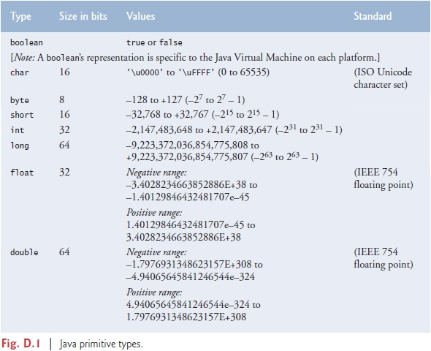

Slide 39
Essentials of Counter-Controlled Repetition
Counter-controlled repetition requires:
  Name of control variable (loop counter)
  Initial value of control variable
  Increment/decrement of control variable through each loop iteration
  Condition that tests for control variable’s final value

Slide 40
Counter-Controlled Repetition
The for Repetition Structure
for
Control variable
Final value
keyword
name
of control variable
for (
int
counter =
1
; counter <=
10
; counter++ )
Initial value
Increment
of control variable
of control variable
Loop-continuation condition
Fig. 5: Components of a typical for structure header.

Slide 41
Counter-Controlled Repetition
The for Repetition Statement
Establish
int counter = 1
initial value
of control variable.
Determine if
true
final value
counter <= 10
Print counter
counter++
of control
Increment
variable has been
the control
reached.
false
Body of loop
variable.
(this may be many
statements)
Fig. 6: Flowcharting a typical for repetition structure.

Slide 42
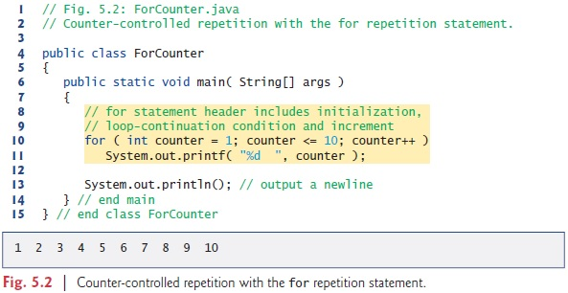
Counter-Controlled Repetition

Slide 43
Counter-Controlled Repetition
class Main {
public static void main(String[] args) {
for (int i=0; i<=10; i++)
System.out.printf("%d ", i);
System.out.println();
}
}

Slide 44
Counter-Controlled Repetition
for(expression1; expression2; expression3)
statement;
Can usually be written as:
expression1;
while ( expression2 )
{
statement;
expression3;
}

Slide 45
Examples Using the for Structure
Varying control variable in for structure
  Vary control variable from 1 to 100 in increments of 1
    for ( int i = 1; i <= 100; i++ )
  Vary control variable from 100 to 1 in decrements of –1
    for ( int i = 100; i >= 1; i-- )
  Vary control variable from 7 to 77 in steps of 7
    for ( int i = 7; i <= 77; i += 7 )

Slide 46
Control Structures
do…while Repetition Statement
  Similar to the while structure
  tests the loop-continuation condition after executing the loop’s body; therefore, the body always executes at least once
action(s)
true
condition
false
Fig. 7: Flowcharting the do/while repetition structure.

Slide 47
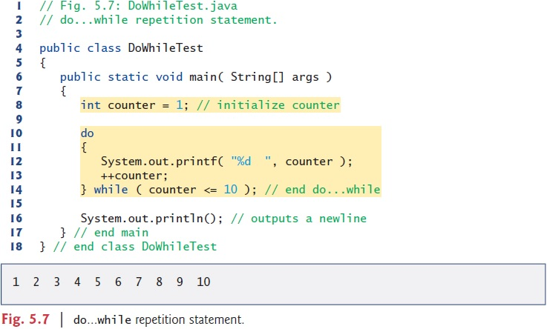
do…while Repetition

Slide 48
The switch Multiple-Selection Structure
switch structure
  Used for multiple selections

Slide 49
The switch Multiple-Selection Structure
true
case a
case a action(s)
break
false
true
case b
case b action(s)
break
false
true
case z
case z action(s)
break
false
default action(s)
Fig. 8: The switch multiple-selection structure.

Slide 50
// Counting letter grades with switch.
import java.util.Scanner;
public class LetterGrades
{
public static void main( String args[] )
{
int total = 0; // sum of grades
int gradeCounter = 0; // number of grades entered
// no. of As, Bs, Cs
int aCount = 0, bCount = 0, cCount = 0, dCount = 0, fCount = 0;
Scanner input = new Scanner(System.in);
System.out.println("Enter the integer grades in the range of 0-100.");
System.out.println("Enter the -1 to terminate the input");
while ( input.hasNext() )
{
int grade = input.nextInt();
if(grade == -1)
break;
total += grade; // add grade to total
++gradeCounter;
switch (grade / 10) // switch nested in while
{
case 9: // grade was between 90
case 10:// and 100, both inclusive
++aCount;
break; // necessary to exit switch
case 8: // grade was between 80 and 89
++bCount;
break;
case 7: // grade was between 70 and 79
++cCount;
break;

Slide 51
case 6: // grade was between 60 and 69
++dCount;
break;
default: // grade was less than 60
++fCount;
break;
} // end switch
} // end while
System.out.println( "\nGrade Report:" );
// if user entered at least one grade...
if ( gradeCounter != 0 )
{
// calculate average of all grades entered
double average = (double) total / gradeCounter;
// output summary of results
System.out.printf( "Total of the %d grades entered is %d\n",
gradeCounter, total );
System.out.printf( "Class average is %.2f\n", average );
System.out.printf( "%s\n%s%d\n%s%d\n%s%d\n%s%d\n%s%d\n",
"Number of students who received each grade:",
"A: ", aCount, // display number of A grades
"B: ", bCount, // display number of B grades
"C: ", cCount, // display number of C grades
"D: ", dCount, // display number of D grades
"F: ", fCount ); // display number of F grades
} // end if
else // no grades were entered, so output appropriate message
System.out.println( "No grades were entered" );
} // end main
} // end class LetterGrades

Slide 52
// Counting letter grades with switch.
import java.util.Scanner;
public class Main {
public static void main( String args[] ) {
int total = 0; // sum of grades
int gradeCounter = 0; // number of grades entered
// no. of As, Bs, Cs
int aCount = 0, bCount = 0, cCount = 0, dCount = 0, fCount = 0;
Scanner input = new Scanner(System.in);
System.out.println("Enter the integer grades in the range of 0-100.");
System.out.println("Enter the -1 to terminate the input");
while ( input.hasNext() ) {
int grade = input.nextInt();
if(grade==-1)
break;
total += grade; // add grade to total
++gradeCounter;
switch(grade/10) {
case 9: // grade was between 90
case 10:// and 100, both inclusive
++aCount;
break; // necessary to exit switch
case 8: // grade was between 80 and 89
++bCount;
break;
case 7: // grade was between 70 and 79
++cCount;
break;
case 6: // grade was between 60 and 69
++dCount;
break;
default: // grade was less than 60
++fCount;
break;
} // end switch
} // end while
System.out.println( "\nGrade Report:" );
// if user entered at least one grade...
if ( gradeCounter != 0 ) {
// calculate average of all grades entered
double average = (double) total / gradeCounter;
// output summary of results
System.out.printf( "Total of the %d grades entered is %d\n",gradeCounter, total );
System.out.printf( "Class average is %.2f\n", average );
System.out.printf( "%s\n%s%d\n%s%d\n%s%d\n%s%d\n%s%d\n","Number of students who received each grade:",
"A: ", aCount, // display number of A grades
"B: ", bCount, // display number of B grades
"C: ", cCount, // display number of C grades
"D: ", dCount, // display number of D grades
"F: ", fCount ); // display number of F grades
} // end if
else
System.out.println( "No grades were entered" );
} // end main
} // end class LetterGrades

Slide 53
The break Statement
Alter flow of control
Causes immediate exit from control structure
  Used in while, for, do/while or switch statements

Slide 54
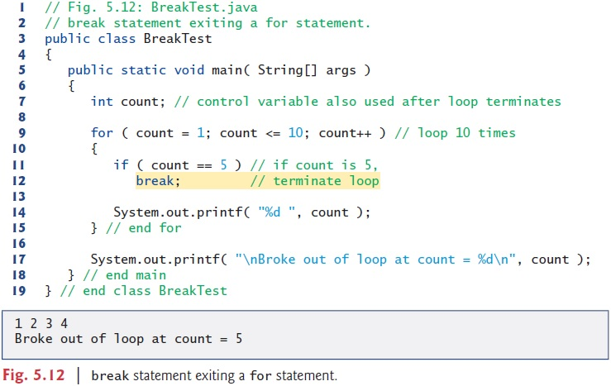
The break Statement

Slide 55
The continue Statement
Alter flow of control
Skips remaining statements in loop body
Proceeds to next iteration
  Used in while, for, do/while statements

Slide 56
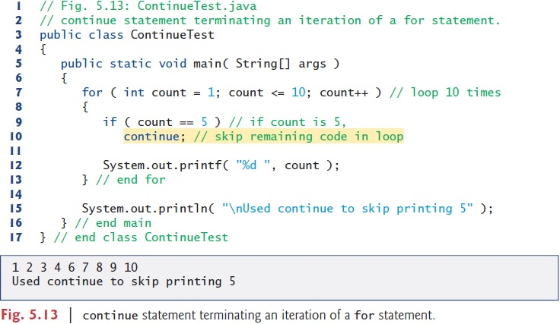
The continue Statement

Slide 57
Logical Operators
Allows for forming more complex conditions
Combines simple conditions
Java logical operators
  && (logical AND)
  & (boolean logical AND)
  || (logical OR)
  | (boolean logical inclusive OR)
  ^ (boolean logical exclusive OR)
  ! (logical NOT)

Slide 58
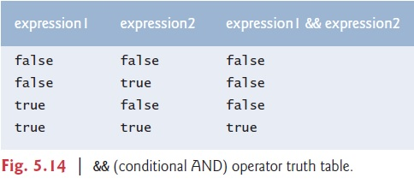
Logical Operators

Slide 59
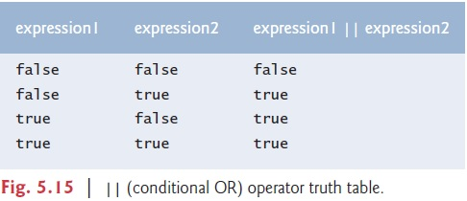
Logical Operators

Slide 60
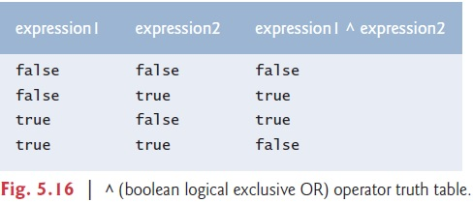
Logical Operators

Slide 61
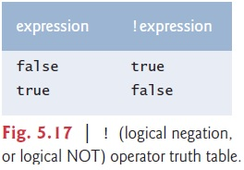
Logical Operators

Slide 62
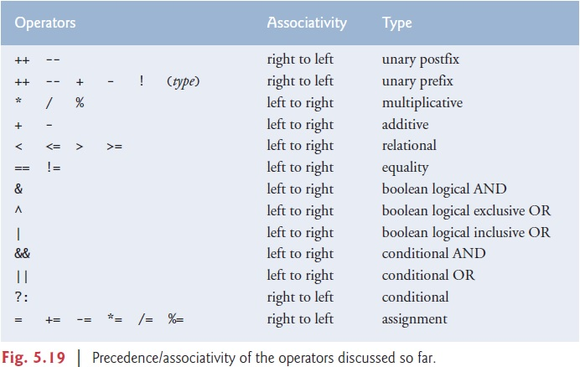

Slide 63
Questions/Answers &
Discussion

